Slide 1
Introduction to ARC Systems
Presenter Name
Advanced Research Computing
Division of IT
Feb 20, 2018

Slide 2
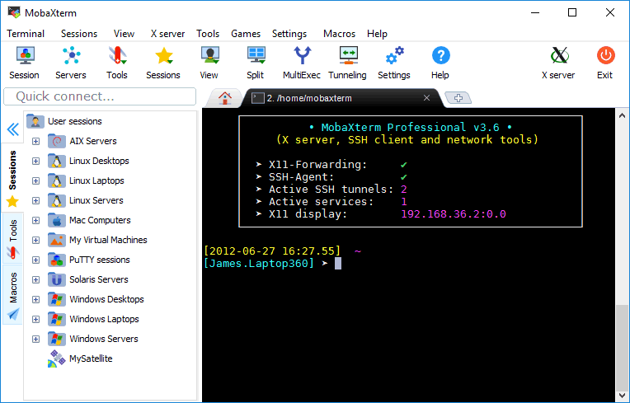
Before We Start
Sign in
Request account if necessary
Windows Users:
MobaXterm
PuTTY
Web Interface:
ETX newriver.arc.vt.edu

Slide 3
Today’s goals
Introduce ARC
Give overview of HPC today
Give overview of VT-HPC resources
Familiarize audience with interacting with VT-ARC systems

Slide 4
Should I Pursue HPC?
Necessity: Are local resources insufficient to meet your needs?
  Very large jobs
  Very many jobs
  Large data
Convenience: Do you have collaborators?
  Share projects between different entities
  Convenient mechanisms for data sharing

Slide 5
Research in HPC is Broad
Earthquake Science and Civil Engineering
Molecular Dynamics
Nanotechnology
Plant Science
Storm modeling
Epidemiology
Particle Physics
Economic analysis of phone network patterns
Brain science
Analysis of large cosmological simulations
DNA sequencing
Computational Molecular Sciences
Neutron Science
International Collaboration in Cosmology and Plasma Physics

Slide 6
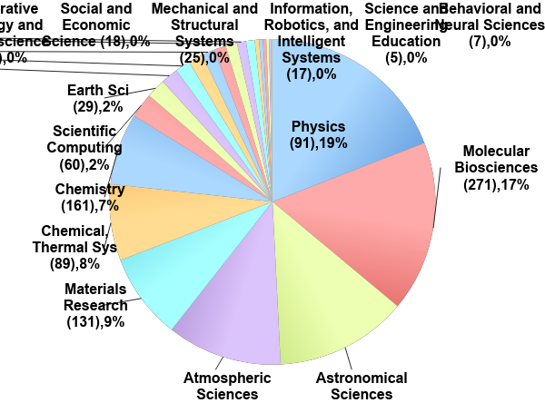
Who Uses HPC?
>2 billion core-hours allocated
1400 allocations
350 institutions
32 research domains
Notes:
.

Slide 7
Popular Software Packages
Molecular Dynamics: Gromacs, LAMMPS, NAMD, Amber
CFD: OpenFOAM, Ansys, Star-CCM+
Finite Elements: Deal II, Abaqus
Chemistry: VASP, Gaussian, PSI4, QCHEM
Climate: CESM
Bioinformatics: Mothur, QIIME, MPIBLAST
Numerical Computing/Statistics: R, Matlab, Julia
Visualization: ParaView, VisIt, Ensight
Deep Learning: Caffe, TensorFlow, Torch, Theano

Slide 8
Learning Curve
Linux: Command-line interface
Scheduler: Shares resources among multiple users
Parallel Computing:
  Need to parallelize code to take advantage of supercomputer’s resources
  Third party programs or libraries make this easier

Slide 9
Advanced Research Computing
Unit within the Office of the Vice President of Information Technology
Provide centralized resources for:
  Research computing
  Visualization
Staff to assist users
Website: http://www.arc.vt.edu

Slide 10
ARC Goals
Advance the use of computing and visualization in VT research
Centralize resource acquisition, maintenance, and support for research community
Provide support to facilitate usage of resources and minimize barriers to entry
Enable and participate in research collaborations between departments

Slide 11
Personnel
Associate VP for Research Computing: Terry Herdman
Director, HPC: Terry Herdman
Director, Visualization: Nicholas Polys
Computational Scientists
  John Burkhardt
  Justin Krometis
  James McClure
  Srijith Rajamohan
  Bob Settlage
  Ahmed Ibrahim

Slide 12
Personnel (Continued)
System Administrators (UAS)
  Matt Strickler
  Josh Akers
Solutions Architects
  Brandon Sawyers
  Chris Snapp
Business Manager: Alana Romanella
User Support GRAs: Mai Dahshan, Negin Forouzesh, Xiaolong Li.

Slide 13
Personnel (Continued)
System & Software Engineers
  Nathan Liles
  Open

Slide 14
Computational Resources
NewRiver
  Cluster targeting data-Intensive problems
DragonsTooth
  jobs that don't require low latency interconnect i.e. pleasingly parallel
  long running, e.g. 30 day wall time
Blue Ridge
  Large scale cluster equipped with Intel Xeon Phi Co-Processors
Cascades – large general compute with GPU nodes
Huckleberry - Machine Learning cluster
Cloud based access (bring your user story)

Slide 15
Compute Resources
System | Usage | Nodes | Node Description | Special Features
BlueRidge | Large-scale CPU, MIC | 408 | 16 cores, 64 GB (2× Intel Sandy Bridge) | 260 Intel Xeon Phi 4 K40 GPU 18 128GB nodes
NewRiver | Large-scale, Data Intensive | 134 | 24 cores, 128 GB (2× Intel Haswell) | 8 K80 GPGPU 16 “big data” nodes 24 512GB nodes 2 3TB nodes 40 P100 nodes
DragonsTooth | Pleasingly parallel, long jobs | 48 | 24 cores, 256 GB (2× Intel Haswell) | 2TB SSD local storage 30 day walltime
Huckleberry | DeepLearning | 14 | Power 8, 256 GB (2x IBM “Minsky S822LC) | 4xP100 / Node NVLink

Slide 16
Computational Resources
Name | NewRiver | DragonsTooth | BlueRidge | Huckleberry
Key Features, Uses | Scalable CPU, Data Intensive | Pleasingly parallel, long running jobs | Scalable CPU or MIC | DeepLearning
Available | August 2015 | August 2016 | March 2013 | Supt 2017
Theoretical Peak (TFlops/s) | 152.6 | .806 | 398.7
Nodes | 134 | 48 | 408 | 14
Cores | 3,288 | 576 | 6,528
Cores/Node | 24 | 24 | 16
Accelerators/Coprocessors | 8 Nvidia K80 GPU | N/A | 260 Intel Xeon Phi 8 Nvidia K40 GPU | 56 Nvidia P100 GPUs
Memory Size | 34.4 TB | 12.3 TB | 27.3 TB
Memory/Core | 5.3 GB* | 10.6 GB | 4 GB*
Memory/Node | 128 GB* | 256 GB | 64 GB* | 512 GB

Slide 17
NewRiver
134 Nodes
3,288 Cores
34.4 TB Memory
EDR InfiniBand (IB) Interconnect
Data-intensive, large-memory, visualization, and GPGPU special-purpose hardware
  8 K80 GPGPU
  16 “big data” nodes
  24 512GB nodes
  2 3TB nodes
  40 dual P100 nodes

Slide 18
NewRiver Nodes
Description | # | Hosts | CPU | Cores | Memory | Local Disk | Other Features
General | 100 | nr027-nr126 | 2 x E5-2680 v3 (Haswell) | 24 | 128 GB, 2133 MHz | 1.8 TB
GPU | 8 | nr019-nr026 | 2 x E5-2680 v3 (Haswell) | 24 | 512 GB | 3.6 TB (2 x 1.8 TB) | NVIDIA K80 GPU
I/O | 16 | nr003-nr018 | 2 x E5-2680 v3 (Haswell) | 24 | 512 GB | 43.2 TB (24 x 1.8 TB) | 2x 200 GB SSD
Large Memory | 2 | nr001-nr002 | 4 x E7-4890 v2 (Ivy Bridge) | 60 | 3 TB | 10.8 TB (6 x 1.8 TB)
Interactive | 8 | newriver1-newriver8 | 2 x E5-2680 v3 (Haswell) | 24 | 256 GB |  | NVIDIA K1200 GPU

Slide 19
Storage Resources
Name | Intent | File System | Environment Variable | Per User Maximum | Data Lifespan | Available On
Home | Long-term storage of files | GPFS (NewRiver) NFS (Other) | $HOME | 500 GB (NewRiver) 100 GB (Other) | Unlimited | Login and Compute Nodes
Group | Shared Data Storage for Research Groups | GPFS (NewRiver) | $GROUP | 10 TB Free per faculty researcher | Unlimited | Login and Compute Nodes
Work | Fast I/O, Temporary storage | GPFS (NewRiver) Lustre (BlueRidge) GPFS (Other) | $WORK | 20 TB (NewRiver) 14 TB (Other) 3 million files | 120 days | Login and Compute Nodes

Slide 20
Storage Resources (continued)
Name | Intent | File System | Environment Variable | Per User Maximum | Data Lifespan | Available On
Archive | Long-term storage for infrequently-accessed files | CXFS | $ARCHIVE | - | Unlimited | Login Nodes
Local Scratch | Local disk (hard drives) |  | $TMPDIR | Size of node hard drive | Length of Job | Compute Nodes
Memory (tmpfs) | Very fast I/O | Memory (RAM) | $TMPFS | Size of node memory | Length of Job | Compute Nodes

Slide 21
Visualization Resources
VisCube: 3D immersive environment with three 10′ by 10′ walls and a floor of 1920×1920 stereo projection screens
DeepSix: Six tiled monitors with combined resolution of 7680×3200
ROVR Stereo Wall
AISB Stereo Wall

Slide 22
Getting Started with ARC
Review ARC’s system specifications and choose the right system(s) for you
  Specialty software
Apply for an account online the Advanced Research Computing website
When your account is ready, you will receive confirmation from ARC’s system administrators

Slide 23
Resources
ARC Website: http://www.arc.vt.edu
ARC Compute Resources & Documentation: http://www.arc.vt.edu/hpc
New Users Guide: http://www.arc.vt.edu/newusers
Frequently Asked Questions: http://www.arc.vt.edu/faq
Linux Introduction: http://www.arc.vt.edu/unix

Slide 24
Thank you
Questions?

Slide 25
Log In
Log in via SSH
  Mac/Linux have built-in client
  Windows need to download client (e.g. PuTTY)
System | Login Address (xxx.arc.vt.edu)
NewRiver | newriver1 to newriver8
Dragonstooth | dragonstooth1
BlueRidge | blueridge1 or blueridge2
HokieSpeed | hokiespeed1 or hokiespeed2
HokieOne | hokieone

Slide 26
Browser-based Access
Browse to http://newriver.arc.vt.edu
Xterm: Opens an SSH session with X11 forwarding (but faster)
Other profiles: VisIt, ParaView, Matlab, Allinea
Create your own!

Slide 27
ALLOCATION SYSTEM

Slide 28
Allocations
“System unit” (roughly, core-hour) account that tracks system usage
Applies only to NewRiver and BlueRidge
http://www.arc.vt.edu/allocations

Slide 29
Allocation System: Goals
Track projects that use ARC systems and document how resources are being used
Ensure that computational resources are allocated appropriately based on needs
  Research: Provide computational resources for your research lab
  Instructional: System access for courses or other training events

Slide 30
Allocation Eligibility
To qualify for an allocation, you must meet at least one of the following:
Be a Ph.D. level researcher (post-docs qualify)
Be an employee of Virginia Tech and the PI for research computing
Be an employee of Virginia Tech and the co-PI for a research project led by non-VT PI

Slide 31
Allocation Application Process
Create a research project in ARC database
Add grants and publications associated with project
Create an allocation request using the web-based interface
Allocation review may take several days
Users may be added to run jobs against your allocation once it has been approved

Slide 32
Allocation Tiers
Research allocations fall into three tiers:
Less than 200,000 system units (SUs)
  200 word abstract
200,000 to 1 million SUs
  1-2 page justification
More than 1 million SUs
  3-5 page justification

Slide 33
Allocation Management
Web-based:
  User Dashboard -> Projects -> Allocations
  Systems units allocated/remaining
  Add/remove users
Command line:
  Allocation name and membership: glsaccount
  Allocation size and amount remaining: gbalance -h -a <name>
  Usage (by job): gstatement -h -a <name>

Slide 34
USER ENVIRONMENT

Slide 35
Consistent Environment
Operating system (CentOS)
Storage locations
Scheduler
Hierarchical module tree for system tools and applications

Slide 36
Modules
Modules are used to set the PATH and other environment variables
Modules provide the environment for building and running applications
  Multiple compiler vendors (Intel vs GCC) and versions
  Multiple software stacks: MPI implementations and versions
  Multiple applications and their versions
An application is built with a certain compiler and a certain software stack (MPI, CUDA)
  Modules for software stack, compiler, applications
User loads the modules associated with an application, compiler, or software stack
  modules can be loaded in job scripts

Slide 37
Module commands
Command | Result
module | List options
module list | List loaded modules
module avail | List available modules
module load <module> | Add a module
module unload <module> | Remove a module
module swap <mod1> <mod2> | Swap two modules
module help <module> | Module environment
module show <module> | Module description
module spider <module> | Search modules
module reset | Reset to default
module purge | Unload all modules

Slide 38
Modules
Available modules depend on:
  The compiler (eg. Intel, gcc) and
  The MPI stack selected
Defaults:
  BlueRidge: Intel + mvapich2
  NewRiver, DragonsTooth: none

Slide 39
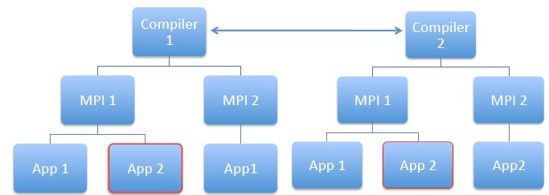
Hierarchical Module Structure

Slide 40
JOB SUBMISSION & MONITORING

Slide 41

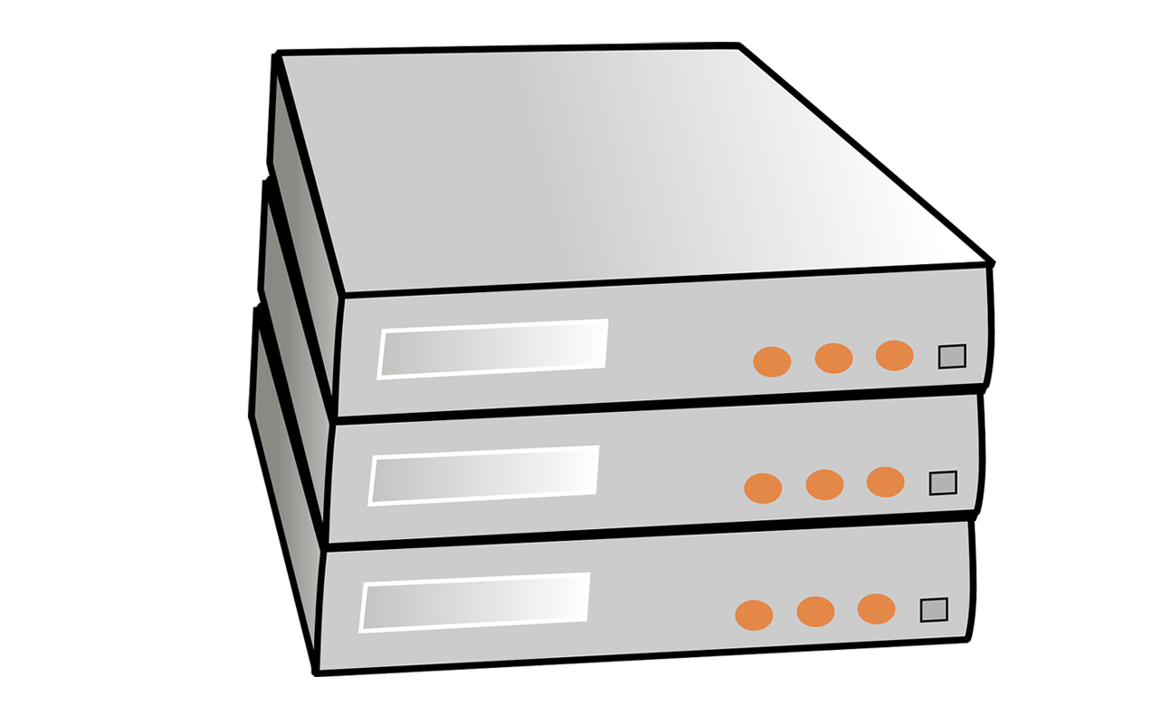
Cluster System overview
Compute
Node 1
User
VT Campus
Internet
Login
Node
Compute
Node 2
Storage
/home
/work
VPN
Compute
Node 3
Off- Campus
Compute
Node N

Slide 42



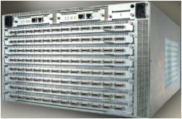
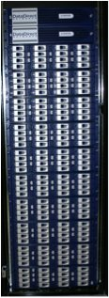

Cluster System Architecture
internet
1
TopSpin 120
Login Nodes
2950
1
TopSpin 270
2
2
InfiniBand
Switch
Hierarchy
Raid 5
Home Server
…
HOME
130
1
2
TopSpin 120
…
16
I/O Nodes
WORK File System
GigE
GigE Switch Hierarchy
InfiniBand
Fibre Channel

Slide 43
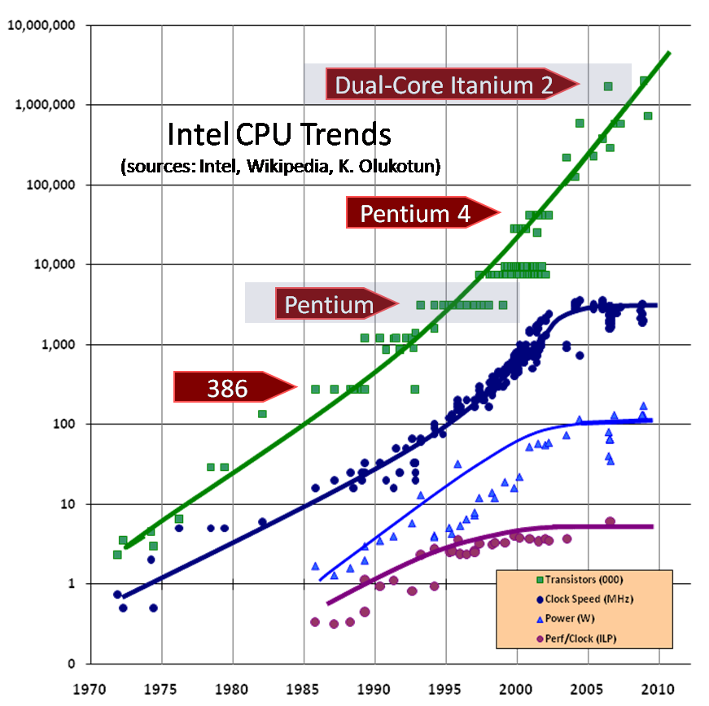
Parallelism is the New Moore’s Law
Power and energy efficiency impose a key constraint on design of micro-architectures
Clock speeds have plateaued
Hardware parallelism is increasing rapidly to make up the difference

Slide 44
Essential Components of HPC
Supercomputing resources
Storage
Visualization
Data management
Network infrastructure
Support

Slide 45
Terminology
Core: A computational “unit”
Socket: A single CPU (“processor”). Includes roughly 4-15 cores.
Node: A single “computer”. Includes roughly 2-8 sockets.
Cluster: A single “supercomputer” consisting of many nodes.
GPU: Graphics processing unit. Attached to some nodes. General purpose GPUs (GPGPUs) can be used to speed up certain kinds of codes.
Xeon Phi: Intel’s product name for its GPU competitor. Also called “MIC”.

Slide 46
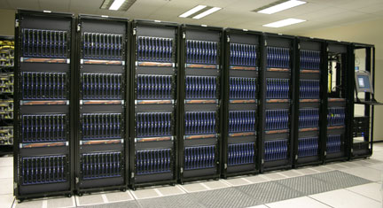
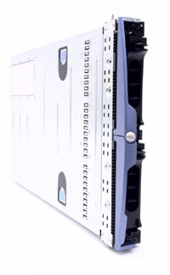
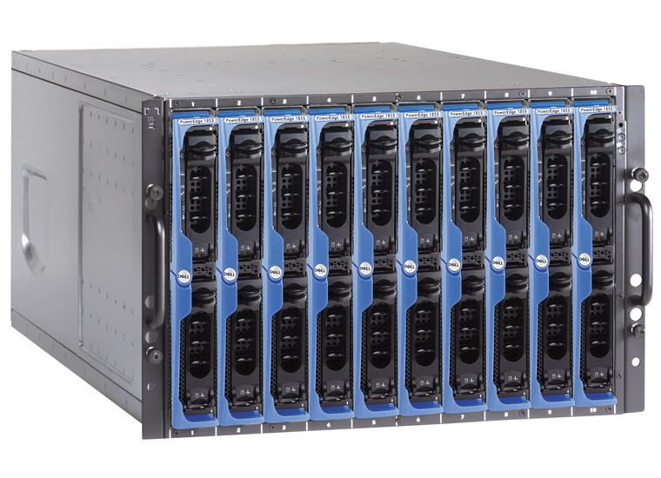
Blade : Rack : System
1 node : 2 x 8 cores= 16 cores
1 chassis : 10 nodes = 160 cores
1 rack (frame) : 4 chassis = 640 cores
system : 10 racks = 6,400 cores
x 4
x 10

Slide 47
HPC Storage
200TB
NFS
$HOME
NFS
NFS
$SHARE
Compute
Node
GPFS
$WORK
GPFS
DMF
GPFS
$SCRATCH
GPFS
Tape archive
HPC Cluster
140TB
Storage Gateway

Slide 48
Shared vs. Distributed memory
M
M
M
M
M
Memory
P
P
P
P
P
P
P
P
P
P
Network
All processors have access to a pool of shared memory
Access times vary from CPU to CPU in NUMA systems
Example: SGI UV, CPUs on same node
Memory is local to each processor
Data exchange by message passing over a network
Example: Clusters with single-socket blades

Slide 49
Multi-core systems
Memory
Memory
Memory
Memory
Memory
Network
Current processors place multiple processor cores on a die
Communication details are increasingly complex
  Cache access
  Main memory access
  Quick Path / Hyper Transport socket connections
  Node to node connection via network

Slide 50
Accelerator-based Systems
Memory
Memory
Memory
Memory
GPU
GPU
GPU
GPU
Network
Calculations made in both CPUs and GPUs
No longer limited to single precision calculations
Load balancing critical for performance
Requires specific libraries and compilers (CUDA, OpenCL)
Co-processor from Intel: MIC (Many Integrated Core)

Slide 51
Submitting a Job
Submission via a shell script
  Job description: Resources required, run time, allocation
  Modules & dependencies
  Execution statements
Submit job script: qsub <job_script>
Interactive options:
  Interactive job: qsub -I …
  Interactive job with X11 forwarding: qsub -I –X …

Slide 52
Job Monitoring
Determine job status, and if pending when it will run
Command | Meaning
checkjob –v JOBID | Get the status and resources of a job
showq | See what jobs are running and cluster utilization
showstart JOBID | Get expected job start time
qdel JOBID | Delete a job

Slide 53
Job Execution
Order of job execution depends on a variety of parameters:
  Submission Time
  Queue Priority
  Backfill Opportunities
  Fairshare Priority
  Advanced Reservations
  Number of Actively Scheduled Jobs per User

Slide 54
Examples: ARC Website
See the Examples section of each system page for sample submission scripts and step-by-step examples:
  http://www.arc.vt.edu/newriver
  http://www.arc.vt.edu/dragonstooth
  http://www.arc.vt.edu/blueridge
  http://www.arc.vt.edu/huckleberry-user-guide

Slide 55
A Step-by-Step Example

Slide 56
Getting Started
Find your training account (hpcXX)
Log into NewRiver
  Mac: ssh hpcXX@cascades1.arc.vt.edu
  Windows: Use PuTTY
    Host Name: cascades1.arc.vt.edu

Slide 57
Example: Running MPI_Quad
Or copy from training directory:
  cp /home/TRAINING/newriver/* ./
Build the code

Slide 58
Compile the Code
Intel compiler is already loaded
  module list
Compile command (executable is mpiqd)
  mpicc -o mpiqd mpi_quad.c
To use GCC instead, swap it out:
  module swap intel gcc

Slide 59
Prepare Submission Script
Copy sample script:
  cp /home/TRAINING/ARC_Intro/br.qsub .
Edit sample script:
  Walltime
  Resource request (nodes/ppn)
  Module commands (add Intel & mvapich2)
  Command to run your job
Save it (e.g., mpiqd.qsub)

Slide 60
Submission Script (Typical)
#!/bin/bash
#PBS -l walltime=00:10:00
#PBS -l nodes=2:ppn=16
#PBS -q normal_q
#PBS -W group_list=newriver
#PBS –A AllocationName <--Only for NewRiver/BlueRidge
module load intel mvapich2
cd $PBS_O_WORKDIR
echo "MPI Quadrature!"
mpirun -np $PBS_NP ./mpiqd
exit;

Slide 61
Submission Script (Today)
#!/bin/bash
#PBS -l walltime=00:10:00
#PBS -l nodes=2:ppn=8
#PBS -q normal_q
#PBS -W group_list=training
#PBS –A training
#PBS –l advres=NLI_ARC_Intro.26
module load intel mvapich2
cd $PBS_O_WORKDIR
echo "MPI Quadrature!"
mpirun -np $PBS_NP ./mpiqd
exit;

Slide 62
Submit the job
Copy the files to $WORK:
  cp mpiqd $WORK
  cp mpiqd.qsub $WORK
Navigate to $WORK
  cd $WORK
Submit the job:
  qsub mpiqd.qsub
Scheduler returns job number:
  25770.master.cluster

Slide 63
Wait for job to complete
Check job status:
  checkjob –v 25770
  showq –u hpcXX
When complete:
  Job output: mpiqd.qsub.o25770
  Errors: mpiqd.qsub.e25770
Copy results back to $HOME:
  cp mpiqd.qsub.o25770 $HOME

Slide 64
What is Job Submission?
Compute Nodes
Login Node
qsub job
Master
Node
ssh
C1
C2
C3
Queue
mpirun –np # ./a.out

Slide 65
Resources
ARC Website: http://www.arc.vt.edu
Compute Resources & Documentation: http://www.arc.vt.edu/hpc
Storage Documentation: http://www.arc.vt.edu/storage
New Users Guide: http://www.arc.vt.edu/newusers
Frequently Asked Questions: http://www.arc.vt.edu/faq
Linux Introduction: http://www.arc.vt.edu/unix
Module Tutorial: http://www.arc.vt.edu/modules
Scheduler Tutorial: http://www.arc.vt.edu/scheduler

Slide 66
Questions
Presenter Name, Email
Computational Scientist
Advanced Research Computing
Division of IT

