Slide 1
Shared-Memory Programming in OpenMP
Advanced Research Computing

Slide 2
Outline
What is OpenMP?
How does OpenMP work?
Architecture
Fork-join model of parallelism
Communication
OpenMP constructs
Directives
Runtime Library API
Environment variables
Notes:
2
Generic ideas about parallel processing
Motivation (beyond assignments)
What we mean by multitasking
How to use directives.
constructs (Parallel regions & working-sharing)
scheduling (& load balancing)
two storage behaviors of data, private and shared
reductions
removing implied barriers
How to atomically execute blocks of code

Slide 3
Supplementary Materials
Login using temporary accounts on Ithaca
Username and password at your desk
ssh hpcXX@ithaca2.arc.vt.edu
Copy example code to your home directory
cp –r /archive/groups/training/OpenMP_EXAMPLES .
More examples can be downloaded:
https://computing.llnl.gov/tutorials/openMP/exercise.html

Slide 4
Overview

Slide 5
What is OpenMP?
API for parallel programming on shared memory systems
Parallel “threads”
Implemented through the use of:
Compiler Directives
Runtime Library
Environment Variables
Supported in C, C++, and Fortran
Maintained by OpenMP Architecture Review Board (http://www.openmp.org/)
Notes:
5
OpenMP: Acronym for open source multi-processing New … (but the concept is old)
SMP: Sym.Mult.Process–implies shared memory machine Sym. means that each processors has equal access to the kernel.
SMP : Shared-memory Parallel Computer
Open: Specification and Revision Reviewed & incorporated into standard by the OpenMP (Arch. Review Board) organization
ANSI committee X3H5 never made it.
OpenMP: MP = Multi-processing
DIR.: Compiler must be modified to handle multiprocessing directive– usually through pthreads.
RUNTIME: An API to query and set execution characteristics.
Env. Used to specify run time options, such as # of PEs and Scheduling.
Orphaned directives in OpenMP offer the features necessary to represent coarse-grained
algorithms.

Slide 6
Advantages
Code looks similar to sequential
Relatively easy to learn
Adding parallelization can be incremental
No message passing
Coarse-grained or fine-grained parallelism
Widely-supported

Slide 7
Disadvantages
Scalability limited by memory architecture
To a single node (8 to 32 cores) on most machines
Managing shared memory can be tricky
Improving performance is not always guaranteed or easy

Slide 8
Shared Memory
Memory
P
P
P
P
P
Your laptop
Multicore, multiple memory NUMA system
HokieOne (SGI UV)
One node on a hybrid system

Slide 9
Fork-join Parallelism
Parallelism by region
Master Thread: Initiated at run-time & persists throughout execution
Assembles team of parallel threads at parallel regions
time
execution
Serial
Parallel
Serial
Parallel
Serial
4 CPU
6 CPU
Master Thread
Multi-Threaded
Notes:
9

Slide 10
How do threads communicate?
Every thread has access to “global” memory (shared). Each thread has access to a stack memory (private).
Use shared memory to communicate between threads.
Simultaneous updates to shared memory can create a race condition. Results change with different thread scheduling.
Use mutual exclusion to avoid data sharing - but don’t use too many because this will serialize performance.
Notes:
10

Slide 11
Race Conditions
Example: Two threads (“T1” & “T2”) increment x=0
Start: x=0
T1 reads x=0
T1 calculates x=0+1=1
T1 writes x=1
T2 reads x=1
T2 calculates x=1+1=2
T2 writes x=2
Result: x=2
Start: x=0
T1 reads x=0
T2 reads x=0
T1 calculates x=0+1=1
T2 calculates x=0+1=1
T1 writes x=1
T2 writes x=1
Result: x=1

Slide 12
OpenMP Basics

Slide 13
OpenMP Constructs
OpenMP language
extensions
parallel control
structures
work sharing
data
environment
synchronization
runtime
functions, env.
variables
governs flow of
control in the
program
parallel directive
distributes work
among threads
do/parallel do
and
Section directives
specifies
variables as
shared or private
shared and
private
clauses
coordinates thread
execution
critical and
atomic directives
barrier directive
Runtime environment
omp_set_num_threads()
omp_get_thread_num()
OMP_NUM_THREADS
OMP_SCHEDULE
Notes:
13
Also : single and master constructs

Slide 14
OpenMP Directives
OpenMP directives specify parallelism within source code:
C/C++: directives begin with the # pragma omp sentinel.
FORTRAN: Directives begin with the !$OMP, C$OMP or *$OMP sentinel.
F90: !$OMP free-format
Parallel regions are marked by enclosing parallel directives
Work-sharing loops are marked by parallel do/for
Fortran
!$OMP parallel
...
!$OMP end parallel
!$OMP parallel do
DO ...
!$OMP end parallel do
C/C++
# pragma omp parallel
{...}
# pragma omp parallel for
for(){...}
14
Notes:
14
Suggestion: Use !$OMP starting in column 1 for F77 and F90.

Slide 15
API: Functions
Function | Description
omp_get_num_threads() | Returns number of threads in team
omp_get_thread_num() | Returns thread ID (0 to n-1)
omp_get_num_procs() | Returns number of machine CPUs
omp_in_parallel() | True if in parallel region & multiple threads executing
omp_set_num_threads(#) | Changes number of threads for parallel region
Function | Description
omp_get_dynamic() | True if dynamic threading is on.
omp_set_dynamic() | Set state of dynamic threading (true/false)

Slide 16
API: Environment Variables
OMP_NUM_THREADS: Number of Threads
OMP_DYNAMIC: TRUE/FALSE for enable/disable dynamic threading

Slide 17
Parallel Regions
1 !$OMP PARALLEL
2 code block
3 call work(…)
4 !$OMP END PARALLEL
Line 1: Team of threads formed at parallel region
Lines 2-3:
Each thread executes code block and subroutine calls
No branching (in or out) in a parallel region
Line 4: All threads synchronize at end of parallel region (implied barrier).
Notes:
17
User is responsible to split work load

Slide 18
Example: Hello World
Update a serial code to run on multiple cores using OpenMP
Start from serial “Hello World” example:
hello.c, hello.f
Create a parallel region
Identify individual threads and print out information from each

Slide 19
Hello World in OpenMP
Fortran:
!$OMP PARALLEL
INTEGER tid
tid = OMP_GET_THREAD_NUM()
PRINT *, ‘Hello from thread = ‘, tid
!$OMP END PARALLEL
C:
#pragma omp parallel
{
int tid;
tid = omp_get_thread_num();
printf(‘Hello from thread =%d\n’, tid);
}

Slide 20
Compiling with OpenMP
GNU uses –fopenmp flag
gcc program.c -fopenmp –o runme
g++ program.cpp –fopenmp –o runme
gfortran program.f –fopenmp –o runme
Intel uses –openmp flag, e.g.
icc program.c -openmp –o runme
ifort program.f –openmp –o runme

Slide 21
OpenMP Constructs

Slide 22
Parallel Region/Work Sharing
Use OpenMP directives to specify Parallel Region and Work-Sharing constructs.
Code block Each Thread Executes
DO Work Sharing
SECTIONS Work Sharing
SINGLE One Thread
MASTER Only the master thread
CRITICAL One Thread at a time
Parallel
End Parallel
Parallel DO/for
Parallel SECTIONS
Stand-alone
Parallel Constructs
Notes:
22
Give opportunity for multiple processors to execute the code.

Slide 23
OpenMP parallel constructs
PARALLEL
{code1}
DO
do I = 1,N*4
{code2}
end do
END DO
{code3}
END PARALLEL
PARALLEL DO
do I = 1,N*4
{code}
end do
END PARALLEL DO
PARALLEL
{code}
END PARALLEL
code1
code1
code1
code1
code
code
code
code
I=1,N
code
I=N+1,2N
code
I=2N+1,3N
code
I=3N+1,4N
code
I=1,N
code2
I=N+1,2N
code2
I=2N+1,3N
code2
I=3N+1,4N
code2
code3
code3
code3
code3
Replicated
Work Sharing
Combined
Notes:
23

Slide 24
More about OpenMP parallel regions…
There are two OpenMP “modes”
static mode
Fixed number of threads
dynamic mode:
Number of threads can change under user control from one parallel region to another (using OMP_set_num_threads)
Specified by setting an environment variable
(csh) setenv OMP_DYNAMIC true
(bash) export OMP_DYNAMIC=true
Note: the user can only define the maximum number of threads, compiler can use a smaller number
Notes:
24

Slide 25
Parallel Constructs
PARALLEL: Create threads, any code is executed by all threads
DO/FOR: Work sharing of iterations
SECTIONS: Work sharing by splitting
SINGLE: Only one thread
CRITICAL or ATOMIC: One thread at a time
MASTER: Only the master thread

Slide 26
The DO / for directive
Fortran:
!$OMP PARALLEL DO
do i=0,N
C do some work
enddo
!$OMP END PARALLEL DO
C:
#pragma omp parallel for
{
for (i=0; i<N; i++)
// do some work
}

Slide 27
The DO / for Directive
1 !$OMP PARALLEL DO
2 do i=1,N
3 a(i) = b(i) + c(i)
4 enddo
5 !$OMP END PARALLEL DO
Line 1 Team of threads formed (parallel region).
Line 2-4 Loop iterations are split among threads.
Line 5 (Optional) end of parallel loop (implied barrier at enddo).
Each loop iteration must be independent of other iterations.
Notes:
27
Work load in example is small
Imagine you would call a complex Subroutine

Slide 28
The Sections Directive
Different threads will execute different code
Any thread may execute a section
#pragma omp parallel
{
#pragma omp sections
{
#pragma omp section
{ // do some work }
#pragma omp section
{ // do some different work }
} // end of sections
} // end of parallel region

Slide 29
Merging Parallel Regions
The !$OMP PARALLEL directive declares an entire region as parallel. Merging work-sharing constructs into a single parallel region eliminates the overhead of separate team formations.
!$OMP PARALLEL
!$OMP DO
do i=1,n a(i)=b(i)+c(i)
enddo
!$OMP END DO
!$OMP DO
do i=1,m x(i)=y(i)+z(i)
enddo
!$OMP END DO
!$OMP END PARALLEL
!$OMP PARALLEL DO
do i=1,n
a(i)=b(i)+c(i)
enddo
!$OMP END PARALLEL DO
!$OMP PARALLEL DO
do i=1,m
x(i)=y(i)+z(i)
enddo
!$OMP END PARALLEL DO
Notes:
29
In a parallel region you do not give up the threads.
If m =n & operations are independent ==> Loops can be merged, too

Slide 30
OpenMP clauses
Control the behavior of an OpenMP directive:
Data scoping (Private, Shared, Default)
Schedule (Guided, Static, Dynamic, etc.)
Initialization (e.g. COPYIN, FIRSTPRIVATE)
Whether to parallelize a region or not (if-clause)
Number of threads used (NUM_THREADS)
Notes:
30
Give them a feel for how clauses can be used to alter the behavior of directives

Slide 31
Private and Shared Data
Shared: Variable is shared (seen) by all processors.
Private: Each thread has a private instance (copy) of the variable.
Defaults: All DO LOOP indices are private, all other variables are shared.
!$OMP PARALLEL DO SHARED(A,B,C,N) PRIVATE(i)
do i=1,N
A(i) = B(i) + C(i)
enddo
!$OMP END PARALLEL DO

Slide 32
Private data example
In the following loop, each thread needs its own PRIVATE copy of TEMP.
If TEMP were shared, the result would be unpredictable since each processor would be writing and reading to/from the same memory location.
!$OMP PARALLEL DO SHARED(A,B,C,N) PRIVATE(temp,i)
do i=1,N
temp = A(i)/B(i)
C(i) = temp + cos(temp)
enddo
!$OMP END PARALLEL DO
A lastprivate(temp) clause will copy the last loop(stack) value of temp to the (global) temp storage when the parallel DO is complete.
A firstprivate(temp) would copy the global temp value to each stack’s temp.
32
Notes:
32

Slide 33
Data Scoping Example (Code)
int tid, pr=-1, fp=-1, sh=-1, df=-1;
printf("BEGIN: pr is %d, fp is %d, sh is %d, df is %d.\n",pr,fp,sh,df);
#pragma omp parallel shared(sh) private(pr,tid) firstprivate(fp)
{
tid = omp_get_thread_num();
printf("Thread %d START : pr is %d, fp is %d, sh is %d, df is %d.\n",tid,pr,fp,sh,df);
pr = tid * 4; fp = pr; sh = pr; df = pr;
printf("Thread %d UPDATE: pr is %d, fp is %d, sh is %d, df is %d.\n",tid,pr,fp,sh,df);
} /* end of parallel section */
printf("END: pr is %d, fp is %d, sh is %d, df is %d.\n",pr,fp,sh,df);

Slide 34
Data Scoping Example (Code)
$ icc -openmp omp_scope.c -o omp_scope
$ ./omp_scope
BEGIN: pr is -1, fp is -1, sh is -1, df is -1.
Thread 0 START : pr is 0, fp is -1, sh is -1, df is -1.
Thread 1 START : pr is 0, fp is -1, sh is -1, df is -1.
Thread 1 UPDATE: pr is 4, fp is 4, sh is 4, df is 4.
Thread 2 START : pr is 0, fp is -1, sh is -1, df is -1.
Thread 2 UPDATE: pr is 8, fp is 8, sh is 8, df is 8.
Thread 0 UPDATE: pr is 0, fp is 0, sh is 0, df is 0.
Thread 3 START : pr is 0, fp is -1, sh is 8, df is 8.
Thread 3 UPDATE: pr is 12, fp is 12, sh is 12, df is 12.
END: pr is -1, fp is -1, sh is 12, df is 12.

Slide 35
Distribution of work - SCHEDULE Clause
!OMP$ PARALLEL DO SCHEDULE(STATIC)
Each CPU receives one set of contiguous iterations (~total_no_iterations /no_of_cpus).
!OMP$ PARALLEL DO SCHEDULE(STATIC,C)
Iterations are divided round-robin fashion in chunks of size C.
!OMP$ PARALLEL DO SCHEDULE(DYNAMIC,C)
Iterations handed out in chunks of size C as CPUs become available.
!OMP$ PARALLEL DO SCHEDULE(GUIDED,C)
Each of the iterations are handed out in pieces of exponentially decreasing size, with C minimum number of iterations to dispatch each time (Important for load balancing.)
Notes:
35

Slide 36
Load Imbalances
Thread 0
Unused Resources
Thread 1
Thread 2
Thread 3
Time

Slide 37
Example - SCHEDULE(STATIC,16)
!$OMP parallel do schedule(static,16)
do i=1,128 !OMP_NUM_THREADS=4
A(i)=B(i)+C(i)
enddo
thread0: do i=1,16
A(i)=B(i)+C(i)
enddo
do i=65,80
A(i)=B(i)+C(i)
enddo
thread1: do i=17,32
A(i)=B(i)+C(i)
enddo
do i = 81,96
A(i)=B(i)+C(i)
enddo
thread2: do i=33,48
A(i)=B(i)+C(i)
enddo
do i = 97,112
A(i)=B(i)+C(i)
enddo
thread3: do i=49,64
A(i)=B(i)+C(i)
enddo
do i = 113,128
A(i)=B(i)+C(i)
enddo
Notes:
37

Slide 38
Scheduling Options
Static
Dynamic
PROS
Low compute overhead
No synchronization overhead per chunk
Takes better advantage of data locality
CONS
Cannot compensate for load imbalance
PROS
Potential for better load balancing, especially if chunk is low
CONS
Higher compute overhead
Synchronization cost associated per chunk of work

Slide 39
Scheduling Options
When shared array data is reused multiple times, prefer static scheduling to dynamic
Every invocation of the scaling would divide the iterations among CPUs the same way for static but not so for dynamic scheduling
!$OMP parallel private (i,j,iter)
do iter=1,niter
...
!$OMP do
do j=1,n
do i=1,n
A(i,j)=A(i,j)*scale
end do
end do
...
end do
!$OMP end parallel

Slide 40
Comparison of scheduling options
name | type | chunk | chunk size | chunk # | static or dynamic | compute overhead
simple static | simple | no | N/P | P | static | lowest
interleaved | simple | yes | C | N/C | static | low
simple dynamic | dynamic | optional | C | N/C | dynamic | medium
guided | guided | optional | decreasing from N/P | fewer than N/C | dynamic | high
runtime | runtime | no | varies | varies | varies | varies
Notes:
40
Runtime is interesting for tests; No recompilation necessary
N - Number of iterations
P - Number of processes (threads)
C - Chunk size

Slide 41
Loop Collapse
Allow collapsing of perfectly nested loops
Will form a single loop and then parallelize it:
!$omp parallel do collapse(2)
do i=1,n
do j=1,n
.....
end do
end do

Slide 42
Matrix Multiplication - Serial
/*** Initialize matrices ***/
for (i=0; i<NRA; i++)
for (j=0; j<NCA; j++)
a[i][j]= i+j;
[etc…also initialize b and c]
/*** Multiply matrices ***/
for (i=0; i<NRA; i++)
for(j=0; j<NCB; j++)
for (k=0; k<NCA; k++)
c[i][j] += a[i][k] * b[k][j];
Notes:
Two key points: (1) Wow this is similar to the serial program we just saw and (2) What each of the differences (circled) mean

Slide 43
Example: Matrix Multiplication
Parallelize matrix multiplication from serial:
C version: mm.c
Fortran version: mm.f
Use OpenMP to parallelize loops
Determine public / private variables
Decide how to schedule loops

Slide 44
Matrix Multiplication - OpenMP
/*** Spawn a parallel region explicitly scoping all variables ***/
#pragma omp parallel shared(a,b,c,nthreads,chunk) private(tid,i,j,k)
{
tid = omp_get_thread_num();
/*** Initialize matrices ***/
#pragma omp for schedule (static, chunk)
for (i=0; i<NRA; i++)
for (j=0; j<NCA; j++)
a[i][j]= i+j;
#pragma omp for schedule (static, chunk)
for (i=0; i<NRA; i++) {
printf("Thread=%d did row=%d\n",tid,i);
for(j=0; j<NCB; j++)
for (k=0; k<NCA; k++)
c[i][j] += a[i][k] * b[k][j];
}
}
Notes:
Two key points: (1) Wow this is similar to the serial program we just saw and (2) What each of the differences (circled) mean

Slide 45
Matrix Multiplication: Work Sharing
Partition by rows:
$$∗$$
$$=$$
Notes:
Graphic to show them how the threads are breaking up the work

Slide 46
Reduction Clause
Thread-safe way to combine private copies of a variable into a single result
Variable that accumulates the result is the “reduction variable”
After loop execution, master thread collects private values of each thread and finishes the (global) reduction
Reduction operators and variables must be declared
46
Notes:
46
Operations that combine multiple elements in an independent way to form a single value.
Change asum and aprod in REDUCTION statement for more interesting/complicated reduction operations.

Slide 47
Reduction Example: Vector Norm

Slide 48
SYNCHRONIZATION

Slide 49
Nowait Clause
When a work-sharing region is exited, a barrier is implied - all threads must reach the barrier before any can proceed.
By using the NOWAIT clause at the end of each loop inside the parallel region, an unnecessary synchronization of threads can be avoided.
!$OMP PARALLEL
!$OMP DO
do i=1,n
work(i)
enddo
!$OMP END DO NOWAIT
!$OMP DO schedule(dynamic,M)
do i=1,m
x(i)=y(i)+z(i)
enddo
!$OMP END DO
!$OMP END PARALLEL

Slide 50
Barriers
Create a barrier to synchronize threads
Barrier is implied at the end of a parallel region
#pragma omp parallel
{
// all threads do some work
#pragma omp barrier
// all threads do more work
}

Slide 51
Mutual Exclusion: Critical/Atomic Directives
ATOMIC For a single command (e.g. incrementing a variable)
CRITICAL Directive: Longer sections of code
!$OMP PARALLEL SHARED(sum,X,Y)
...
!$OMP CRITICAL
call update(x)
call update(y)
sum=sum+1
!$OMP END CRITICAL
...
!$OMP END PARALLEL
!$OMP PARALLEL SHARED(X,Y)
...
!$OMP ATOMIC
sum=sum+1
...
!$OMP END PARALLEL
Master Thread
CRITICAL section

Slide 52
Mutual exclusion: lock routines
When each thread must execute a section of code serially, locks provide a more flexible way of ensuring serial access than CRITICAL and ATOMIC directives
call OMP_INIT_LOCK(maxlock)
!$OMP PARALLEL SHARED(X,Y)
...
call OMP_set_lock(maxlock)
call update(x)
call OMP_unset_lock(maxlock)
...
!$OMP END PARALLEL
call OMP_DESTROY_LOCK(maxlock)

Slide 53
Performance Optimization

Slide 54
OpenMP wallclock timers
Real*8 :: omp_get_wtime, omp_get_wtick() (Fortran)
double omp_get_wtime(), omp_get_wtick(); (C)
double t0, t1, dt, res;
...
t0 = omp_get_wtime();
<work>
t1 = omp_get_wtime();
dt = t1 - t0;
res = 1.0/omp_get_wtick();
printf(“Elapsed time = %lf\n”,dt);
printf(“clock resolution = %lf\n”,res);

Slide 55
Timer Comparison
#Case 1:
Normal C Timer: 0.230 seconds
OpenMP Timer: 0.105319 seconds
#Case 2 (more efficient threading):
Normal C Timer: 0.200 seconds
OpenMP Timer: 0.012919 seconds

Slide 56
Shared memory to OpenMP
All processors connected to same memory and all memory is identical
Memory
P
P
P
P
P

Slide 57
Reality is More Complicated
Ithaca node (8 cores, 24 GB memory):
2 sockets with 4 cores each
32 KB L1 cache, 256KB L2 cache, 8MB L3 cache
Memory
L3
L3
L2
L2
L2
L2
L2
L2
L2
L2
L1
L1
L1
L1
L1
L1
L1
L1
P
P
P
P
P
P
P
P

Slide 58
likwid-topology

Slide 59
likwid-topology

Slide 60
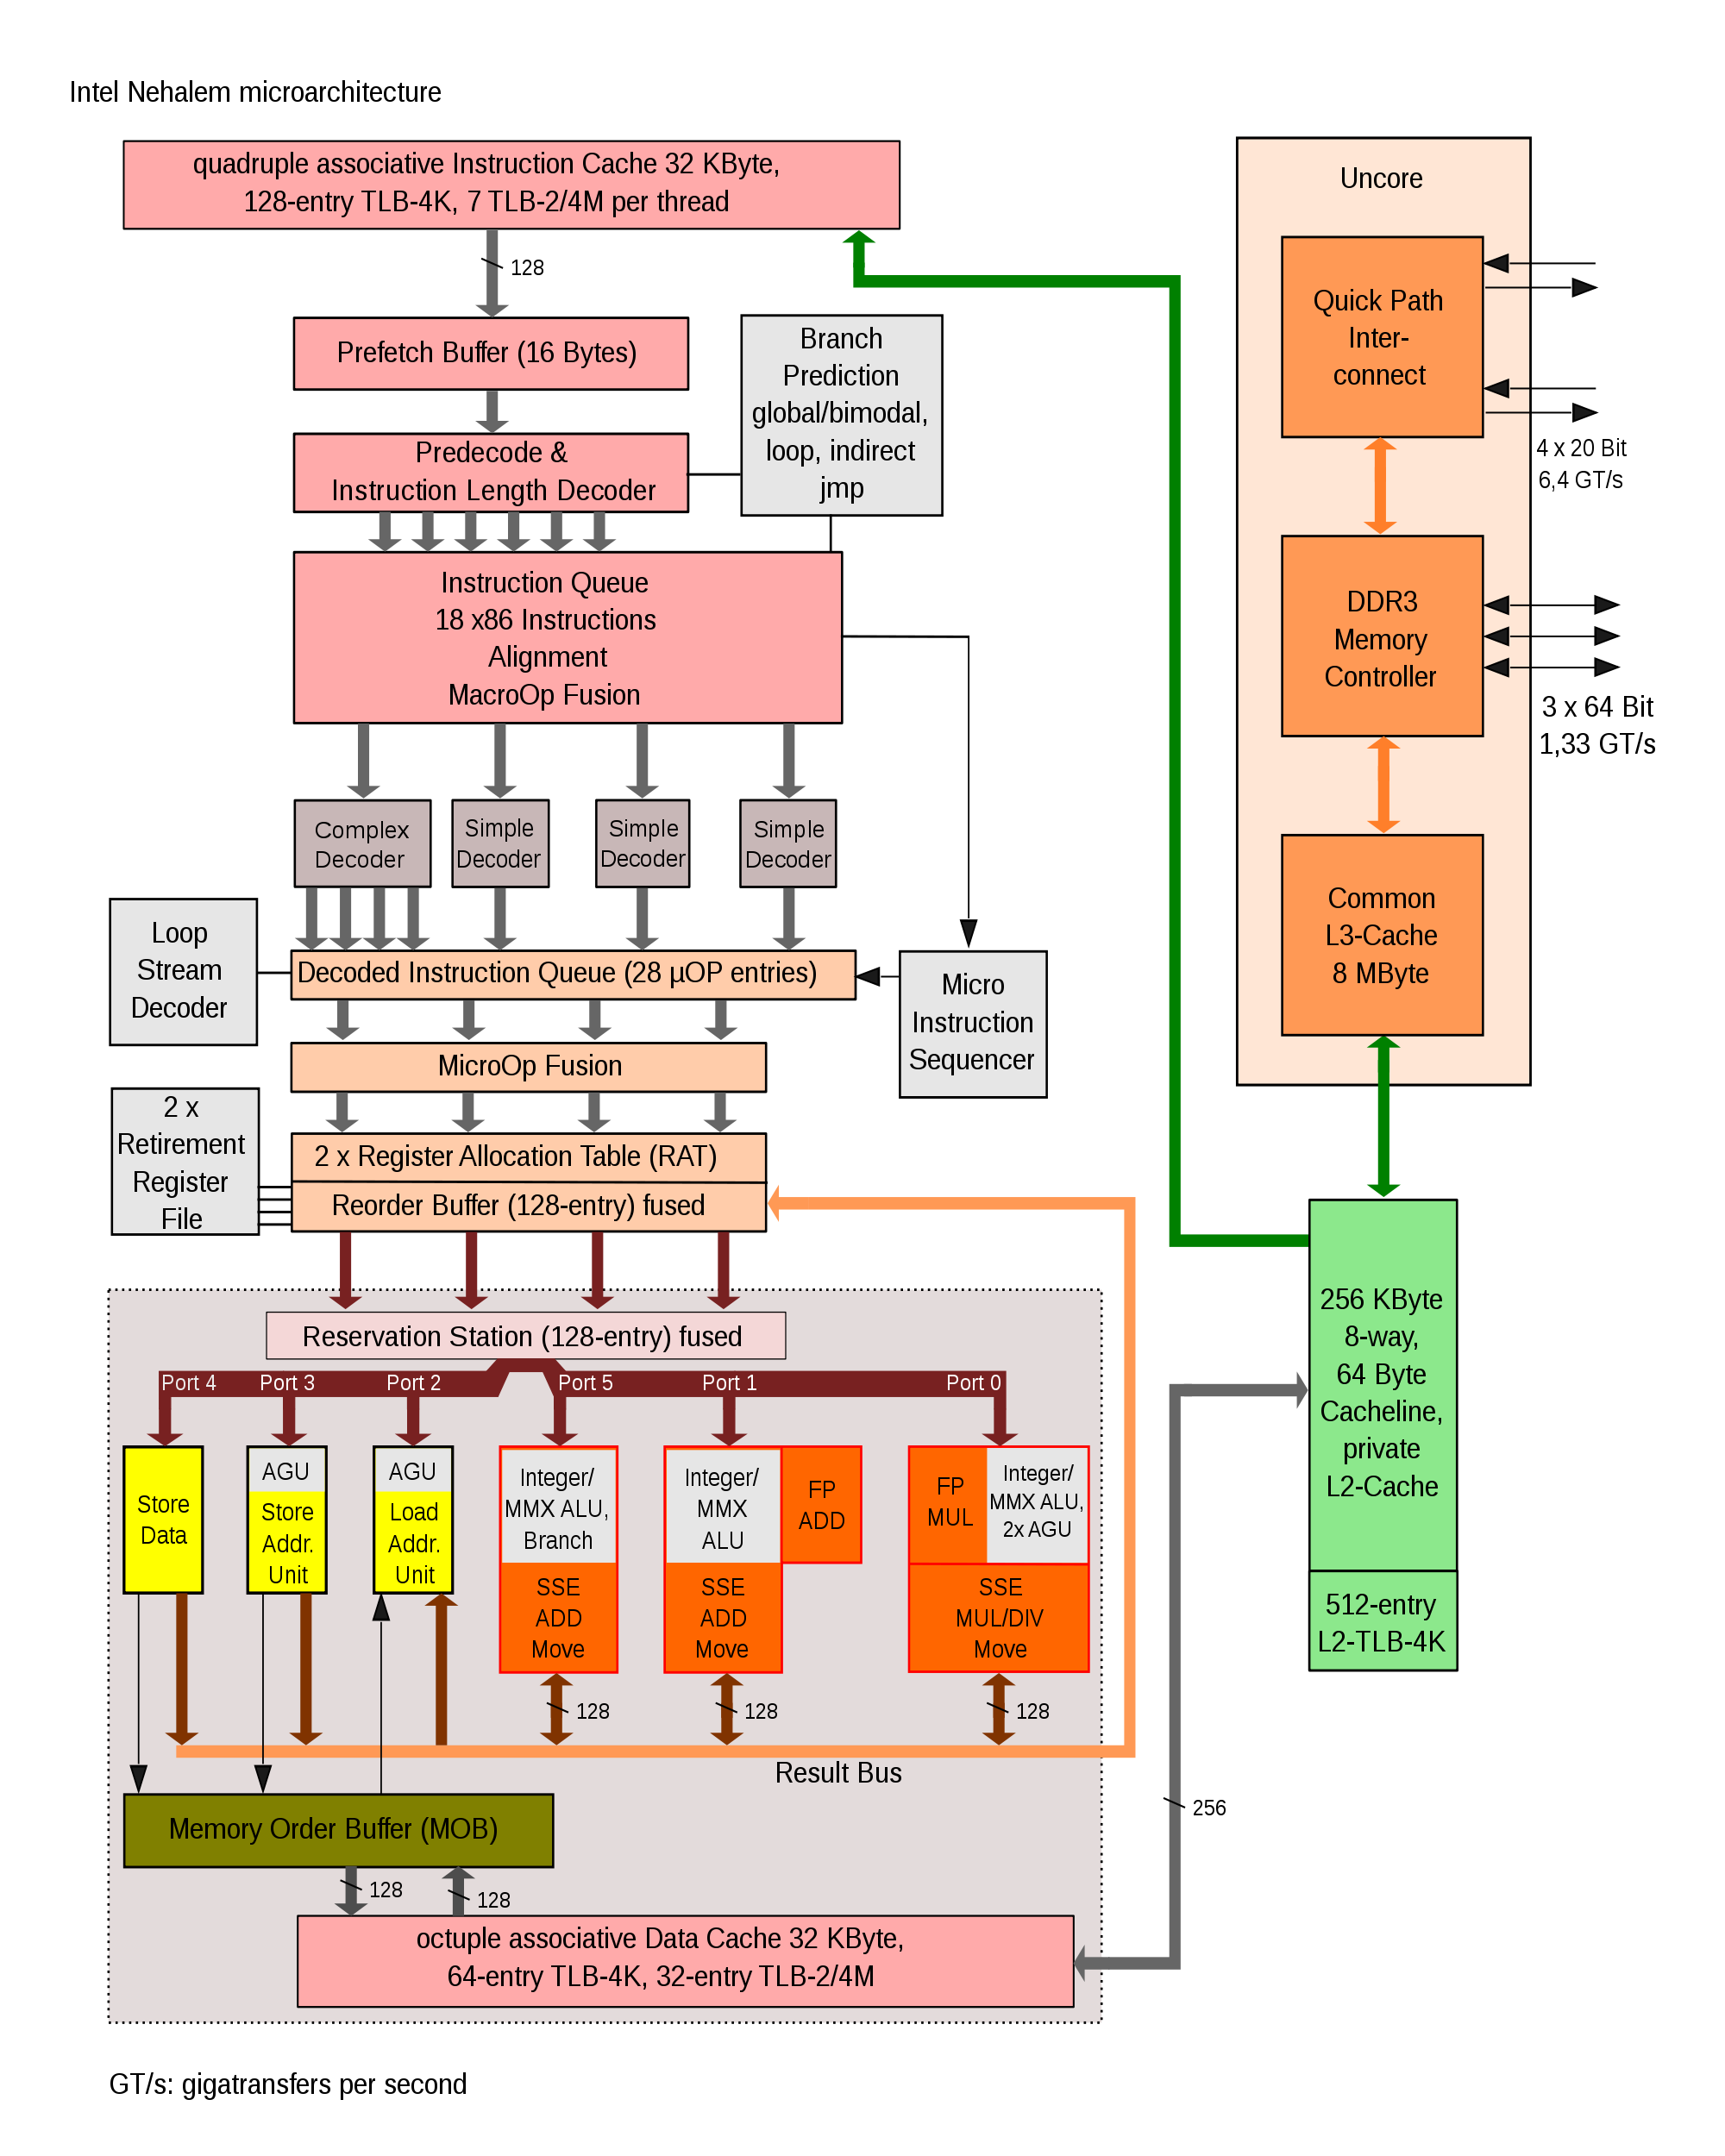
OpenMP and cc-NUMA
cc-NUMA = cache coherent non-uniform memory access
Modern CPU’s utilize multiple levels of cache to reduce the time to get data to the ALU

Slide 61
OpenMP and cc-NUMA
Setup is advantageous because it allows individual CPU cores to get data more quickly from memory
Maintaining cache coherence is expensive
Result: you want to associate specific memory to specific CPU cores

Slide 62
OpenMP and cc-NUMA
Bind specific threads to specific cores:
Intel: export KMP_AFFINITY="proclist=[$CPUSET]"
GCC: export GOMP_CPU_AFFINITY="$CPUSET"
Associate memory with a specific thread:
First-touch policy: use parallel initialization so that values are initialized by the thread that will modify the value

Slide 63
SAXPY Example (Code)
//serial initialization:
//OS will allocate all data close to initial thread
for (i=0;i<N;i++) a[i]=b[i]=c[i]=0.0;
//saxpying with poor memory placement
#pragma omp parallel for
for(i=0;i<N;i++) a[i]=b[i]+scalar*c[i];
//parallel initialization: data allocated where used
# pragma omp parallel for
for (i=0;i<N;i++) a[i]=b[i]=c[i]=0.0;
//saxpying with optimal memory placement
#pragma omp parallel for
for(i=0;i<N;i++) a[i]=b[i]+scalar*c[i];

Slide 64
SAXPY Example (Output)
$ icc -openmp omp_saxpy.c -o saxpy
$ ./saxpy
SAXPY with Serial Initialization:
Elapsed time = 0.105552
SAXPY with Parallel Initialization:
Elapsed time = 0.012795

Slide 65
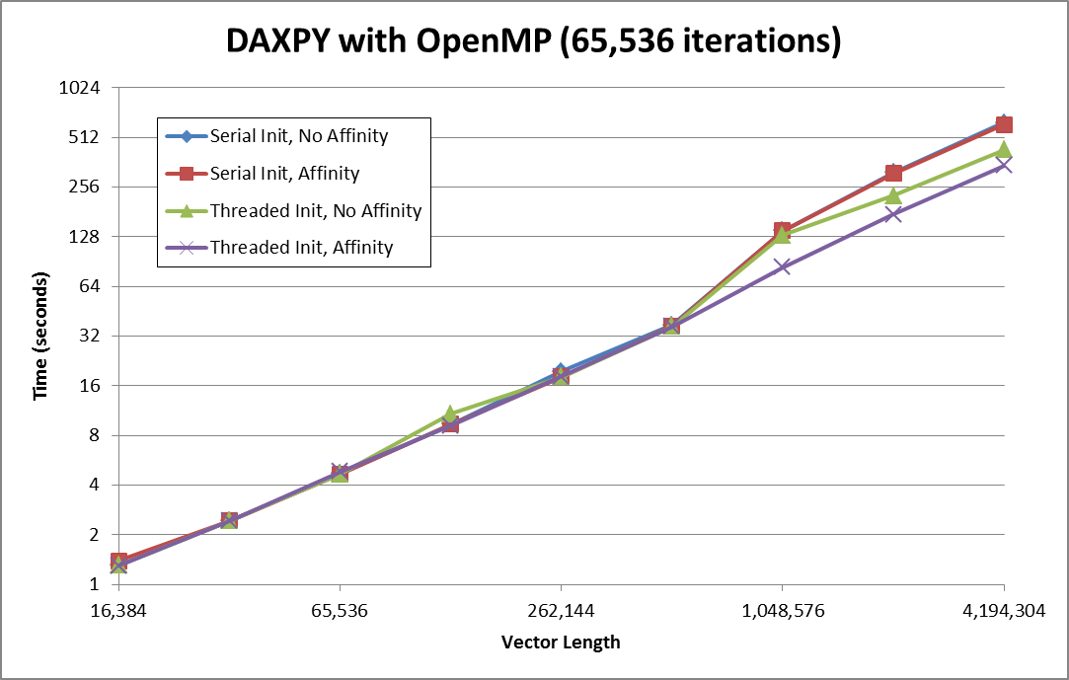
Simple Example, Part 1

Slide 66
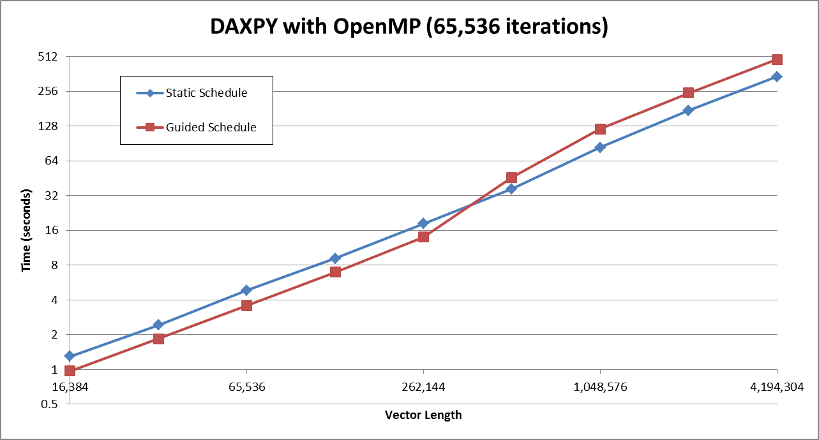
Simple Example, Part 2

Slide 67
Exercise: Performance Optimization
Insert a timer into your OpenMP code
Run the code using 1,2,4,8 cores – does your code scale as you increase the number of cores?
Can you make the code run faster?
Improve load balancing
Reduce overhead
Parallel initialization

Slide 68
Online Content
ARC OpenMP page: http://www.arc.vt.edu/openmp
OpenMP Application Programming Interface: http://www.openmp.org/mp-documents/OpenMP4.0.0.pdf
LLNL Examples: https://computing.llnl.gov/tutorials/openMP/exercise.html

Slide 69
Thank You!

