Slide 1
first,
we get a grasp of these darn coins!

Slide 2
first lets review distinguishable vs indistinguishable
strictly business (coming next…)
What is the sample space of flipping two distinguishable coins
n
(
)
=
4
(H,H)
(H,T)
(T,H)
(T,T)
=
x
H,T
H,T

Slide 3
first lets review distinguishable vs indistinguishable
strictly business (coming next…)
What is the sample space of flipping two indistinguishable coins
n
(
)
=
3
(H,H)
(H,T)
(T,H)
(T,T)

Slide 4
first lets review distinguishable vs indistinguishable
strictly business (coming next…)
What is the sample space of flipping three distinguishable coins
n
(
)
=
(H,H,H)
(H,H,T)
8
(H,T,H)
(H,T,T)
(T,H,H)
(T,H,T)
(T,T,H)
(T,T,T)
=
x
x
H,T
H,T
H,T

Slide 5
first lets review distinguishable vs indistinguishable
strictly business (coming next…)
What is the sample space of flipping three indistinguishable coins
n
(
)
=
(H,H,H)
(H,H,T)
4
(H,T,H)
(H,T,T)
(T,H,H)
(T,H,T)
(T,T,H)
(T,T,T)

Slide 6
first lets review distinguishable vs indistinguishable
strictly business (coming next…)
So what have we seen?
Distinguishable is a cross product
and
Indistinguishable is not!
Then how do we count indistinguishable?

Slide 7
first lets review distinguishable vs indistinguishable
strictly business (coming next…)
How many Tails?
1
No Tails:
(H,H,H)
=
+
4
1
One Tail:
(H,T,H)
+
1
Two Tails:
(T,T,H)
+
1
Three Tails:
(T,T,T)

Slide 8
first lets review distinguishable vs indistinguishable
strictly business (coming next…)
So for n indistinguishable coins?
How many Tails?
No Tails
1
+
=
n+1
1
One Tail
+
.
.
.
.
.
.
+
n Tails
1

Slide 9
first lets review distinguishable vs indistinguishable
strictly business (coming next…)
How about dice?
What is the sample space of rolling two distinguishable die?
n
(
)
(1,1)
(1,2)
(1,3)
(1,4)
(1,5)
(1,6)
(2,1)
(2,2)
(2,3)
(2,4)
(2,5)
(2,6)
=36
(3,1)
(3,2)
(3,3)
(3,4)
(3,5)
(3,6)
(4,1)
(4,2)
(4,3)
(4,4)
(4,5)
(4,6)
(5,1)
(5,2)
(5,3)
(5,4)
(5,5)
(5,6)
(6,1)
(6,2)
(6,3)
(6,4)
(6,5)
(6,6)
=
x
1,2,3,4,5,6
1,2,3,4,5,6

Slide 10
first lets review distinguishable vs indistinguishable
strictly business (coming next…)
How about dice?
What is the sample space of rolling n distinguishable die?
Still Cross Product!
6 X 6 X … X 6
n-times
n
= 6

Slide 11
first lets review distinguishable vs indistinguishable
strictly business (coming next…)
How about dice?
What is the sample space of rolling two indistinguishable die?
n
(
)
(1,1)
(1,2)
(1,3)
(1,4)
(1,5)
(1,6)
(2,1)
(2,2)
(2,3)
(2,4)
(2,5)
(2,6)
=21
(3,1)
(3,2)
(3,3)
(3,4)
(3,5)
(3,6)
(4,1)
(4,2)
(4,3)
(4,4)
(4,5)
(4,6)
(5,1)
(5,2)
(5,3)
(5,4)
(5,5)
(5,6)
(6,1)
(6,2)
(6,3)
(6,4)
(6,5)
(6,6)

Slide 12
first lets review distinguishable vs indistinguishable
strictly business (coming next…)
How about dice?
What is the sample space of rolling n inistinguishable die?
0
… n
How many 1’s
0
How many 2’s
0 1 2 … n
0
How many 3’s
0 1 2 … n
1 2 … n
2 … n
0
.
0
.
0 1 2 … n
0
2 … n
.
How many 4’s
.
.
.
.
.
.

Slide 13
first lets review distinguishable vs indistinguishable
strictly business (coming next…)
How about dice?
What is the sample space of rolling n inistinguishable die?
Yeesh!
I will never ask this!

Slide 14
Now, Back to our regularly scheduled program

Slide 15
Relative probability
Strictly business

Slide 16
Strictly business
You can’t always know everything…
Robert Vandermolen

Slide 17
Relative frequency
Strictly business
We have already seen this!
A total of 1.9 million hybrid vehicles had been sold in the United States through October 2011. Of these 955,000 were Toyota Prius; 205,000 were Honda Civics; 170,000 were Toyota Camrys; 105,000 were Ford Escapes; and the rest were different makes
We don’t know how many will actually be sold!

Slide 18
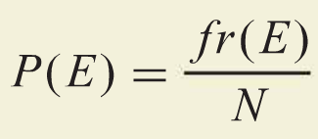
Relative frequency
Strictly business
We have already seen this!
How many times E happens

Slide 19
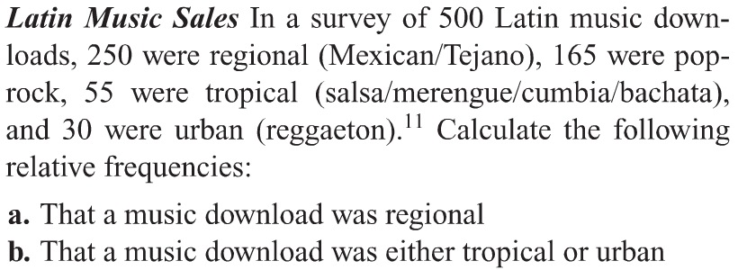
Relative frequency
Strictly business
We have already seen this!

Slide 20
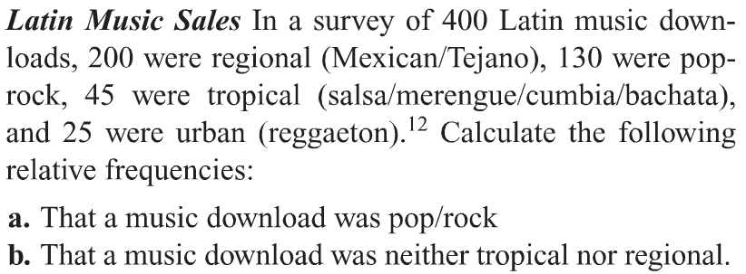
Relative frequency
Strictly business
We have already seen this!

Slide 21
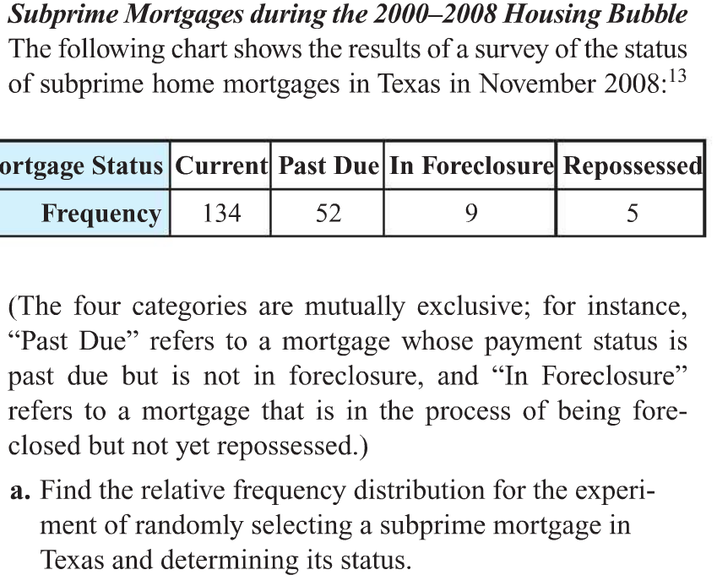
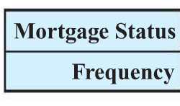
Relative frequency
Strictly business
We have already seen this!

Slide 22
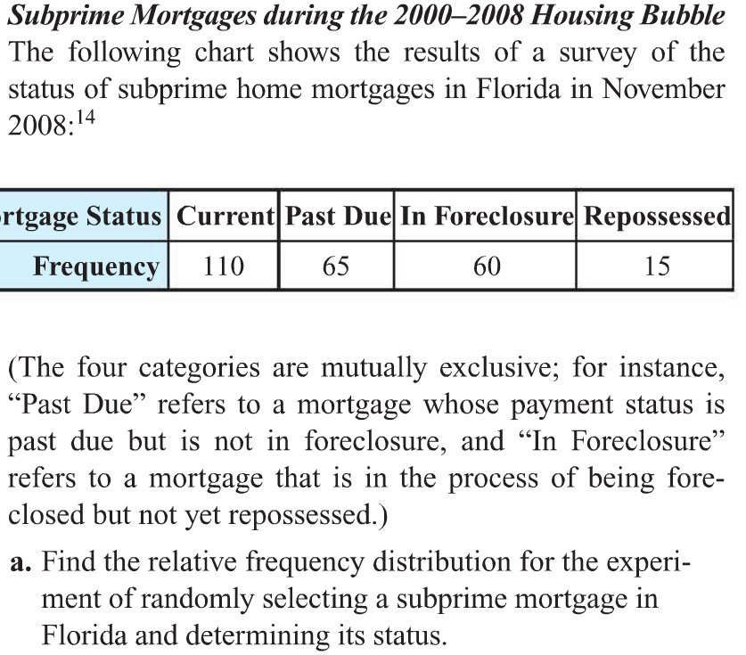
Relative frequency
Strictly business

