Slide 1
Group Work
Getting to know your graphs

Slide 2
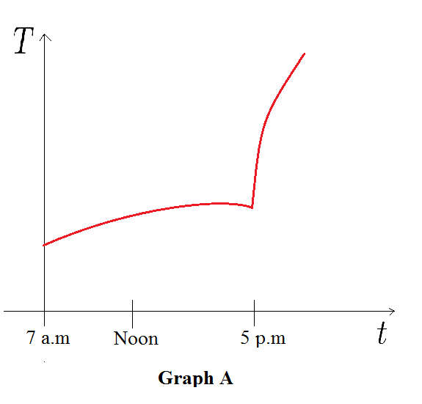
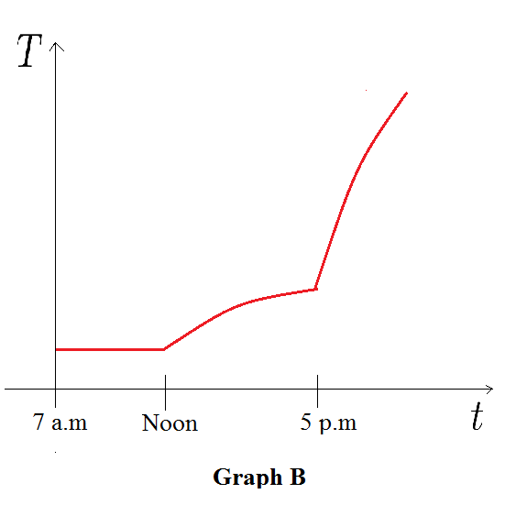
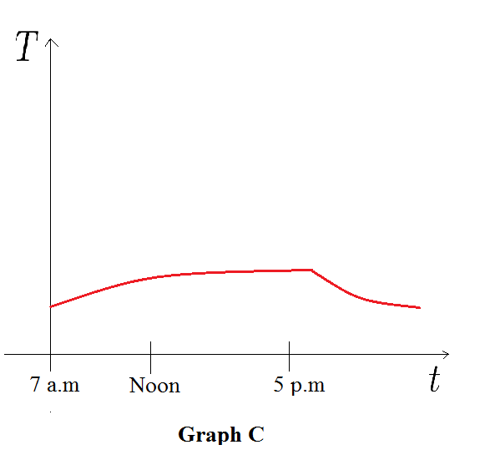
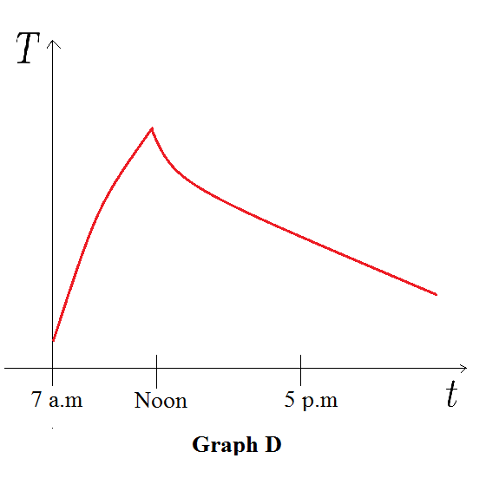
Reading a Story From your Graph:
The Four Graphs below, are graphs of time, (starting at 7 a.m.) versus temperature, for the following stories
match each of the stories with one of the graphs, and for the graph that doesn’t match to any story write your
own similar story:
Story 1: I took a roast out of the freezer at noon and left it on the counter to thaw. Then I cooked it in the oven when
I got home.
A
Story 2: I took the roast out of the freezer in the morning and left it on the counter to thaw. Then I cooked it in the
oven when I got home.
B
Story 3: I took a roast out of the freezer in the morning and left it on the counter to thaw. I forgot about it and went
to a deli for dinner on my way home from work. I put the roast in the refrigerator when I finally got home.
C

Slide 3
Reading a Story From your Graph:
Make your own story, about the roast!

Slide 4
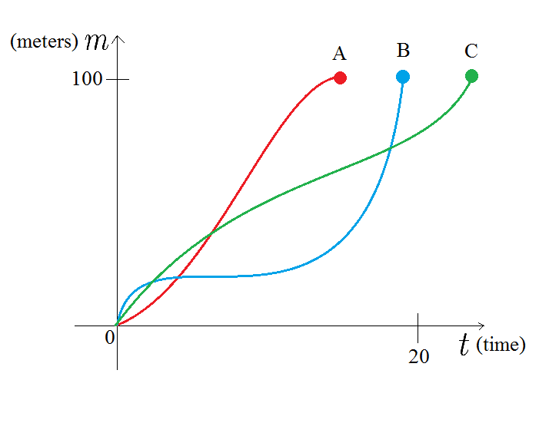
Reading a Story From your Graph:
Three runners complete in a 100 – meter hurdle race. The graph shows the distance run as a function of time for
Each runner. Describe what the graph tells you about the race. Who won the race? Did each runner finish the race?
What do you think happened to Runner B?

Slide 5
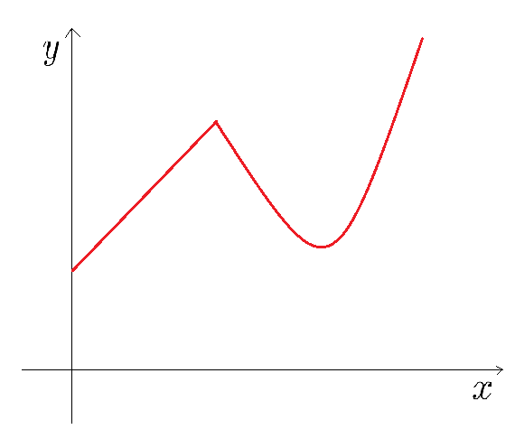
Reading a Story From your Graph:
Make up a story involving any situation that would correspond to the graph shown below.

