Slide 1
Guerilla Data Inc.
Presents:

Slide 2
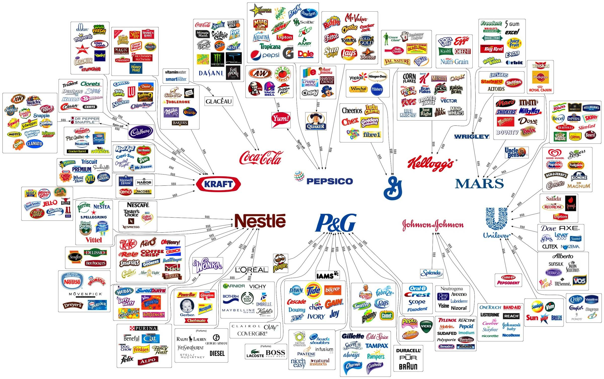
The Hunt for Demographics

Slide 3
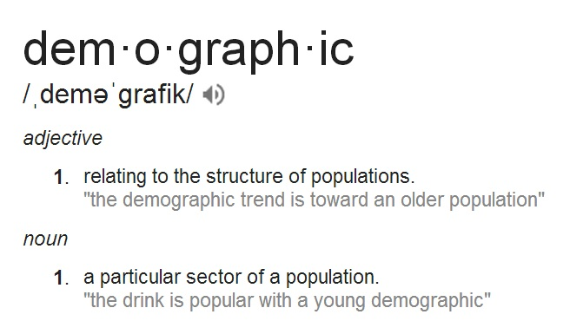

Slide 4
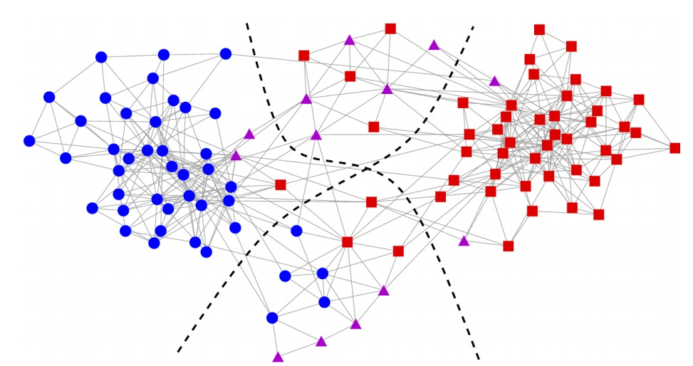
Is this a grouping Question?
We would like to split the population into different groups (communities).

Slide 5
How was this done in the Past?
Gender
Age
Race
Income

Slide 6
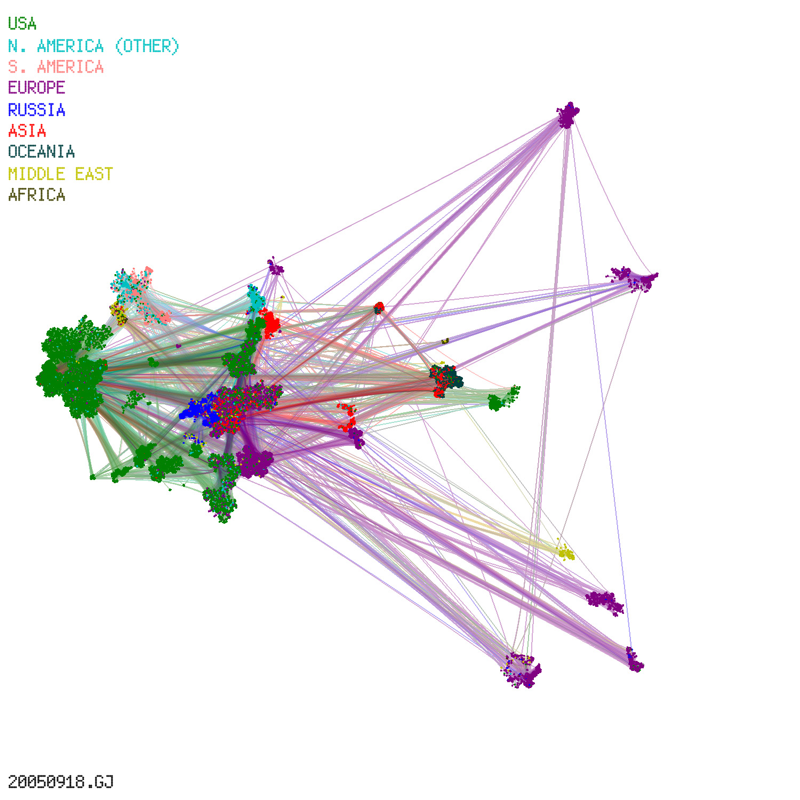
How does this relate to grouping graphs?
Node = Person
Edge = same (age, gender, race, income)

Slide 7
What about
Soccer moms?

Slide 8
We Need More!
Family
Beliefs
Education
?? Suggestions ??

Slide 9
Can we do it another way?
WAIT!!!
How about Purchases?
How do we
group them?
Node = person
Edge = same/similar purchase

Slide 10
Presents:

Slide 11
The Hunt for Demographics
Part II:
The Mathematics
of
Grouping

Slide 12
Grouping graphs:
We would like to group the graph in a “meaningful”
way.
We have taken the time to attach meaning to the
graph, so we would like the groups to represent a
meaningful relationship.

Slide 13
We attempt to make
it more approachable
and give it a friendlier name!
The following is known as
Modularity
(Girvan and Newman 2004)
What does meaningful mean?

Slide 14
The Method of Optimizing the Meaningful Metric
Define meaningful to be:
M = (number of edges within groups)-
(expected number within groups).
By choosing our groups to have a high meaningful
metric reduces the chances of the group’s
connections to be attributed to randomness.
That is the graph has been grouped in a
“meaningful” way.

Slide 15
What is expected???

Slide 16
Expected Edges
The Naive Approach:
P=(number of edges)/(number of pairs)
the probability that if I grab a random pair they have an edge between them.
This method will give us a grouping
with significance…yet for a thorough
dissection…

Slide 17
Expected Edges
The Sophisticated Approach:
Two Methods:
Erdos and Renyi
“Configuration Model”

Slide 18
Expected Edges
The Erdos Renyi Method:
Where
The number of graphs which can be made
with nodes and edges.
The number of graphs which have the
property we want.

Slide 19
Expected Edges
The Erdos Renyi Method:
The Probability a given pair of nodes have an
edge (single edge case)

Slide 20
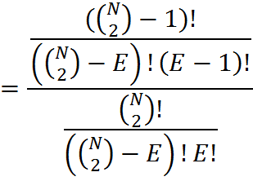
Expected Edges
The Erdos Renyi Method:
The Probability a given pair of nodes have an
edge (single edge case)

Slide 21
Expected Edges
The Erdos Renyi Method:
The Probability a given pair of nodes have an
edge (single edge case)
This Case is just the Naive
method we already saw

Slide 22
Expected Edges
The Configuration Model:
Where
The number of edges which connect to
node .
The number of edges in the graph.

Slide 23
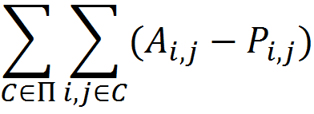
The Meaningful Metric
such that
is a partition of the graph
is the entry of the adjacency matrix
is the probability there is an edge
connecting the pair

Slide 24
Can we formulate this into a model?
Has someone done it before?

Slide 25
Why?

Slide 26
Can we do it another way???

Slide 27
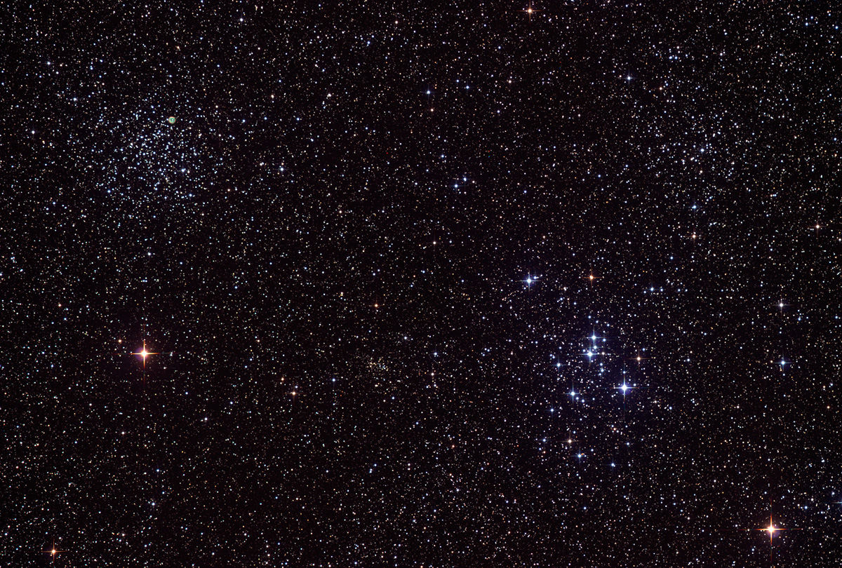
The Hunt for Demographics
Part II:
Episode IV:
A New hope

